Slide 1



BASIC EDUCAITION AND LITERACY
Lakshya | 13th March, 2021

Slide 2


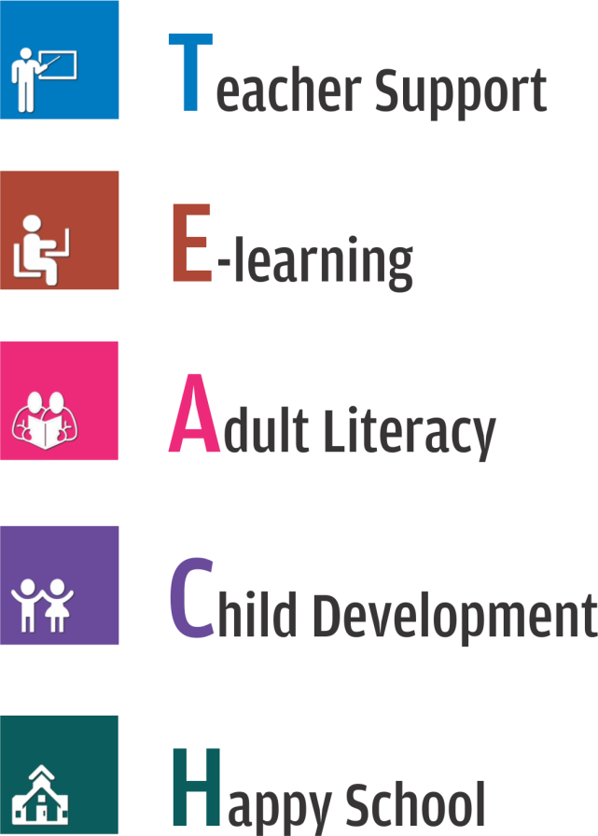


Slide 3

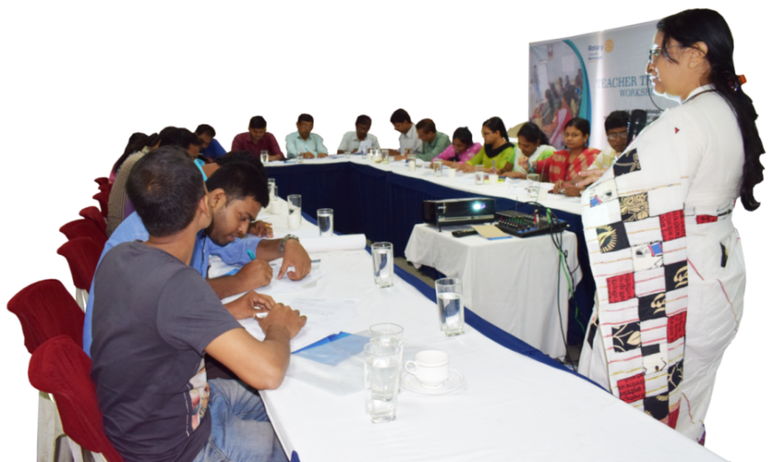

Training of teachers to improve professional development and performance of teachers
Recognition to outstanding teachers with Nation Builder Award (NBA)
w w w . r o t a r y t e a c h . o r g

Slide 4
Teacher Training program
Online Training: Online Teacher Training program initiated to improve the professional abilities and performance of teachers in a blended model approach
6 Training Partners on board
In Person Training: basic (2-day) and advance (5-day) training to teachers. 5 training partners on board
w w w . r o t a r y t e a c h . o r g

Slide 5






Online Teacher Training
Online Teacher Training Partner | Logo | Focus Area of Training | Cost of Training per teacher | Training Reachout
Tech Mahindra Foundation |  | DigitaL Literacy and Teacher Professional Development , Cyber Security and Safety | No cost allocated | 10,000 teachers
Tata Community Initiatives Trust |  | Facilitator Professional Development in a blended model | Rs 300/- inclusive of GST | as per requirement
Meritrain Education Services |  | 21st Century Skills | Rs 300/- + GST | 3.24 lacs teachers
Indian Career and Development Education Council (ICEDC) |  | Professional Development of 21st Century Educator | Rs 400/- + GST | I lac
IT Skills for a Smart Remote Teacher |  | Digitally SMART teacher | No cost allocated | 1.5 lacs
Learning Links Foundation |  | Teacher Professional Development in MGML( Multi Grade Multi Level ) classrooms | Rs294/-+ GST | 10,000 teachers
w w w . r o t a r y t e a c h . o r g

Slide 6




In person TEACHER training
(Approximate Cost Rs. 1,200/- – Rs. 1,600/- per teacher)
w w w . r o t a r y t e a c h . o r g

Slide 7
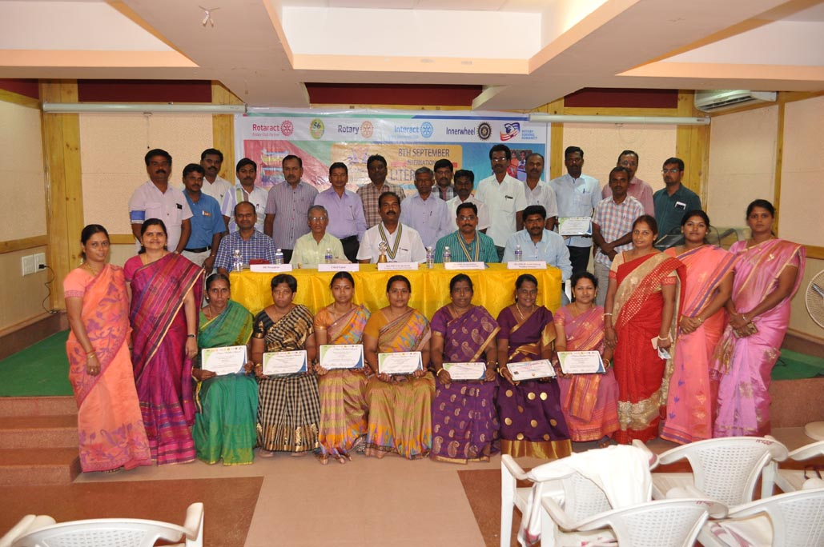
Nation Builder Award
Evaluation based model – teacher in charge and student evaluate the teachers. Best scoring teacher get NBA.
Forms for evaluation on RILM website www.rotaryteach.org
NBA Certificates can be downloaded from rotaryteach portal
w w w . r o t a r y t e a c h . o r g

Slide 8
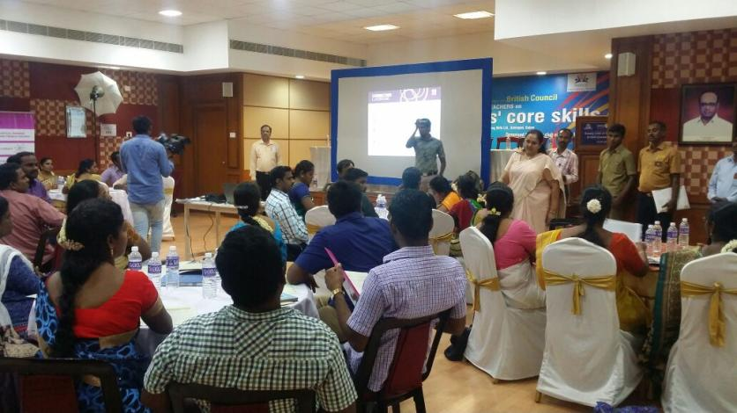
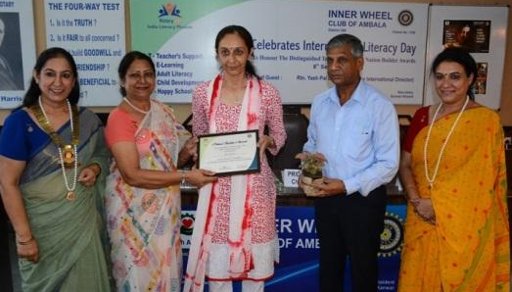
  Teacher Support
1,80,707
Teachers Trained across India
7 Million children are estimated to be benefitting from this project.
A Teacher Training workshop in association with British Council by RID 2982
  Nation Builder Award
27,254
Teachers felicitated with Nation Builder Award
Felicitation of a teacher with NBA by
IWC Ambala Cant.
w w w . r o t a r y t e a c h . o r g

Slide 9

  Expected from Rotarians
Conduct teacher training through RILM portal
Select topics and select training partners
Enroll local resource persons where applicable
Conduct in person evaluation of NBA by Students and Principals coming September
EXPECTED
w w w . r o t a r y t e a c h . o r g

Slide 10

  Support from RILM
Training Partnership development on various topics
Online portal management
Provide auto generated certificates to the teachers
Club recognition
SUPPORT
w w w . r o t a r y t e a c h . o r g

Slide 11
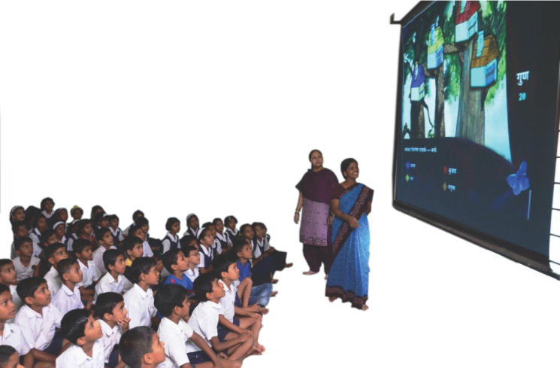
Single classroom integrated solution of hardware and software.
Content mapped with state board in vernacular from Class I – XII.
w w w . r o t a r y t e a c h . o r g

Slide 12
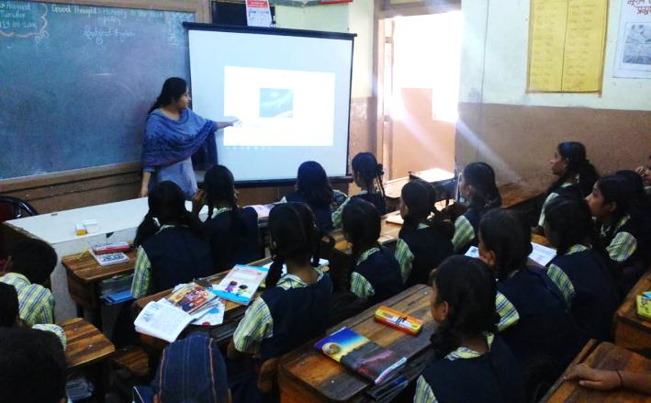
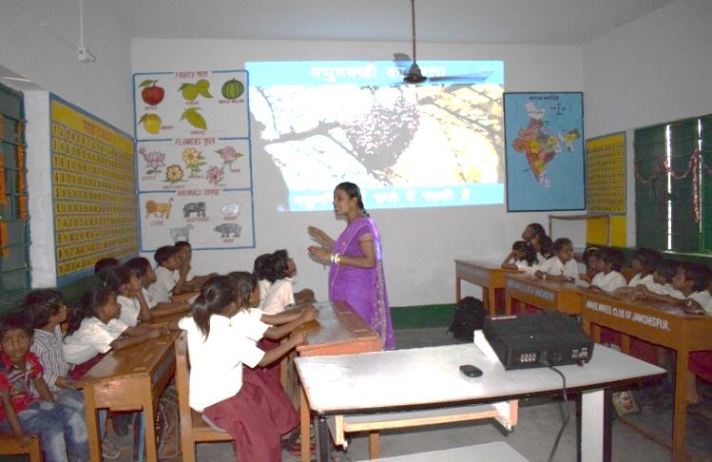
  E-learning across India
16,169
E-learning facilities (Hardware & Software) installed across India
Students of Kendriya Vidyalaya, Pune being taught science using E-learning
Program Impact
20 Lakh (approx.) Students from Govt. and Govt. aided schools
45,000 teachers
E-learning class in progress at Mahatopara Prathamik Vidyalaya
w w w . r o t a r y t e a c h . o r g

Slide 13


  E-learning across India
NCERT TV Tie-up
  Curriculum modules from class 1- 12 to be telecasted through national Television channels of NCERT and other private players.
  DIKSHA App tie-up
  Modules available on DIKSHA mobile application by MHRD, student-interactivity options available
w w w . r o t a r y t e a c h . o r g

Slide 14
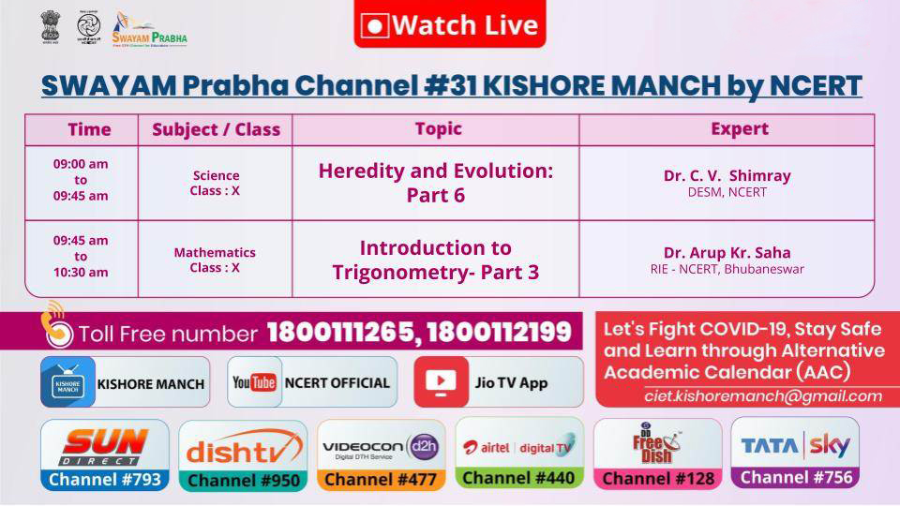
  Watch NOW ON :
w w w . r o t a r y t e a c h . o r g

Slide 15

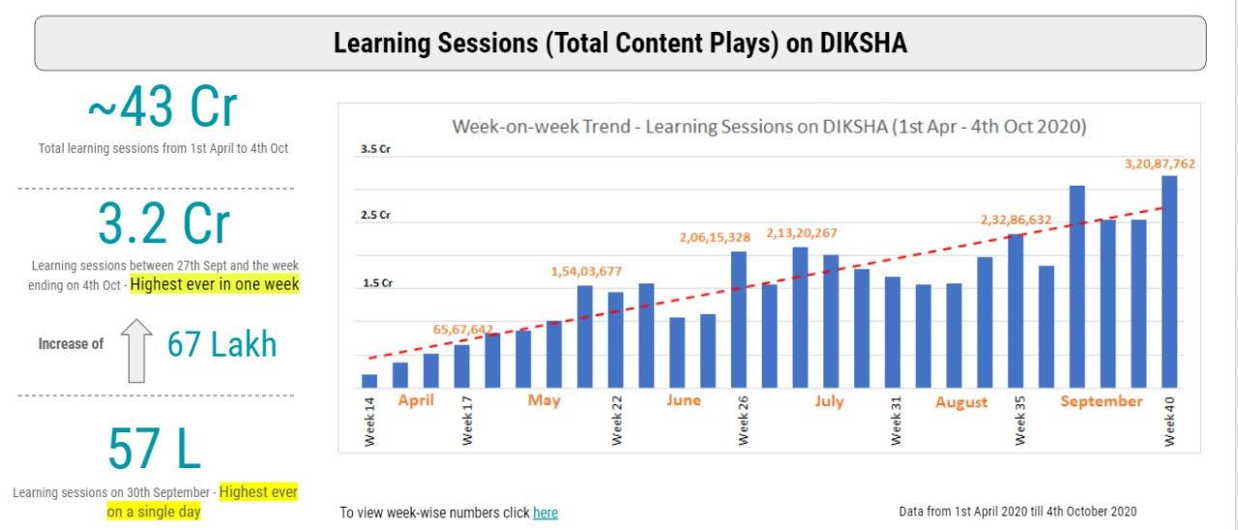
  Medium of REACH
  9 Billion hits (Mar’20 – Dec’20)
  DIKSHA App tie-up
  Modules available on DIKSHA mobile application by MHRD, student-interactivity options available.
RILM Content on DIKSHA / PM eVidya TV
- Schools in 15 states in India studies in Hindi & English medium
- Our content is now available to 10-crore students of Hindi & English Medium
w w w . r o t a r y t e a c h . o r g

Slide 16

  App / Web TV based solutions
  Tata Sky
  Reach: 70.26 Million
Jio TV
Reach: 420 Million
    As DTH TV access is available in all villages & towns
    As DTH TV access is available in all villages & towns
  DD Free Dish
  Reach: 15 million households
    Through government national television channels access is available in all villages & towns
w w w . r o t a r y t e a c h . o r g

Slide 17
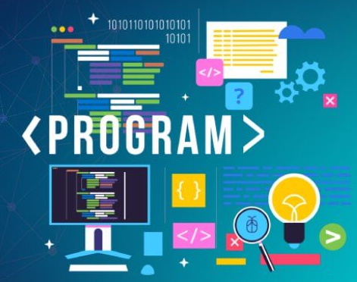
  Programs for Rotarians
NCERT approved National content to be given to states after proper mapping.
Rotarians can start talking to Education departments of respective states for providing software.
For languages other than Hindi, Rotarians can facilitate the process of translation.
w w w . r o t a r y t e a c h . o r g

Slide 18


Slide 19


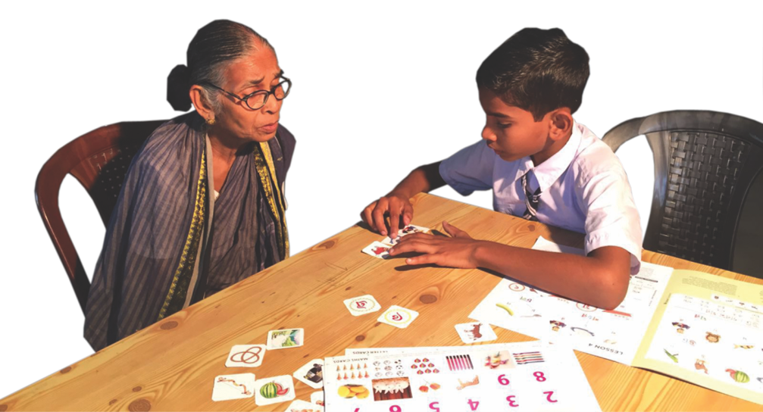
DIKSHA Primer
87,870
Adults reached
through Diksha
and Swabhimaan
w w w . r o t a r y t e a c h . o r g

Slide 20
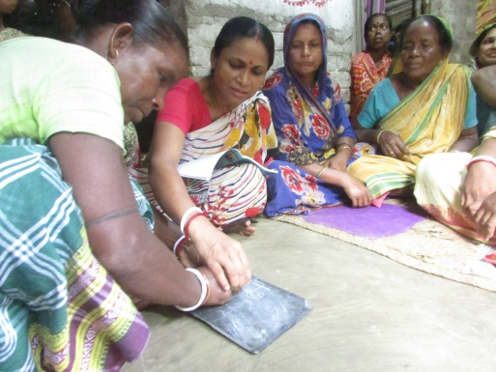
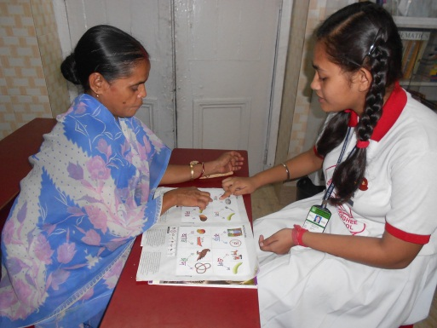
VARIOUS APPROACHES
VIDYA
  Partnership with organization having large membership or follower base
SHIKSHA
  Partnership with grassroot organizations for reaching out to schools for Diksha approach
DIKSHA
  Through student volunteers
SWABHIMAAN
  Through adult literacy centres by Rotary Clubs/Districts
w w w . r o t a r y t e a c h . o r g

Slide 21
VIDYA Approach
Rotarians to identify and explore willingness of the large organizations (Partner Organization, PO) to join hands for ‘Total Literacy’
Facilitate MoU between RILM and PO
RILM to give training to master trainers of PO
Master trainers to give training to volunteers at their respective places
Volunteers to make an adult literate by using the primer developed by RILM
Upload the information about volunteer teachers and adult non-literates on RILM portal of adult literacy
w w w . r o t a r y t e a c h . o r g

Slide 22
Existing Partnerships
Partnerships – VIDYA Approach
Ongoing Discussions
Brahmakumaris
The Bharat Scouts and Guides
Private Schools and Children Welfare Association
Gayatri Pariwar
Association of Muslim Professionals
Sri Ram Chandra Mission
Rashtriya Swayamsevak Sangh

Slide 23
Teaching Material & Availability
For imparting the functional literacy course to the non-literate adults, following resources can be used:
Primer developed by RILM
  To be ordered online by paying per set that includes primer and Question-Answer booklet
  Bengali, Hindi, Kannada, Marathi, Telugu, Odiya & Gujarati
Any other primer available locally and found better
  Details to be shared with RILM so that it can be used by others too
w w w . r o t a r y t e a c h . o r g

Slide 24
  Role of Rotarians
To initiate dialogue with organizations having large follower/member base to have partnership
To get involved and support the local administration for program implementation at local level
To directly implement the program
To initiate dialogue with State Governments for State level partnerships
w w w . r o t a r y t e a c h . o r g

Slide 25
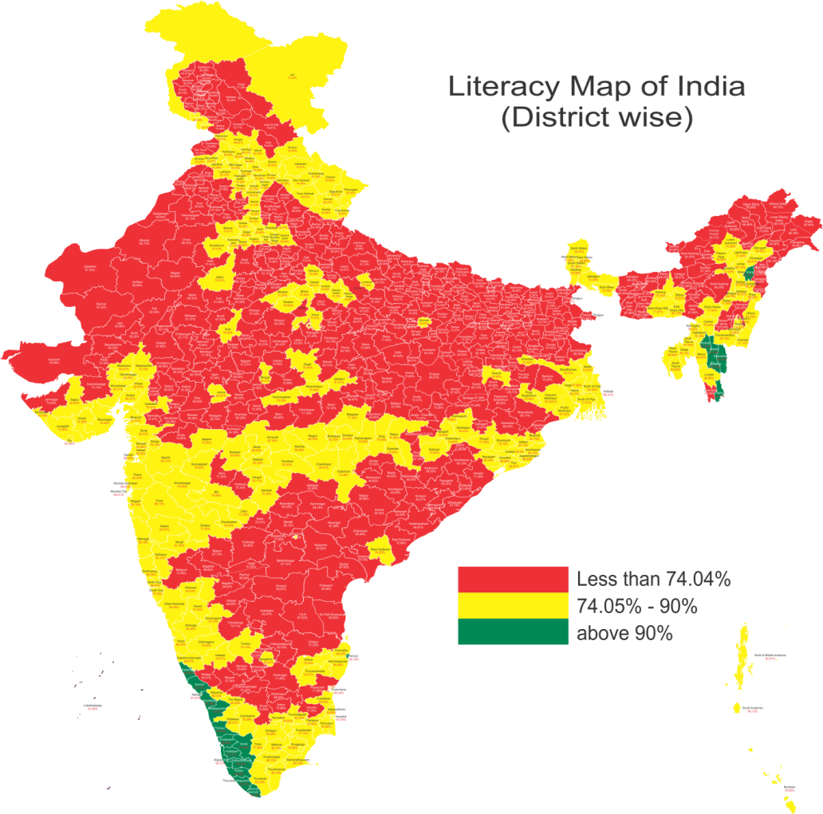
There is a need to make the entire map green
Mapping has been done on the basis of census 2011 data
Data on revenue district literacy rate is available with RILM and can be obtained for deciding the geographical area for intervention
w w w . r o t a r y t e a c h . o r g

Slide 27
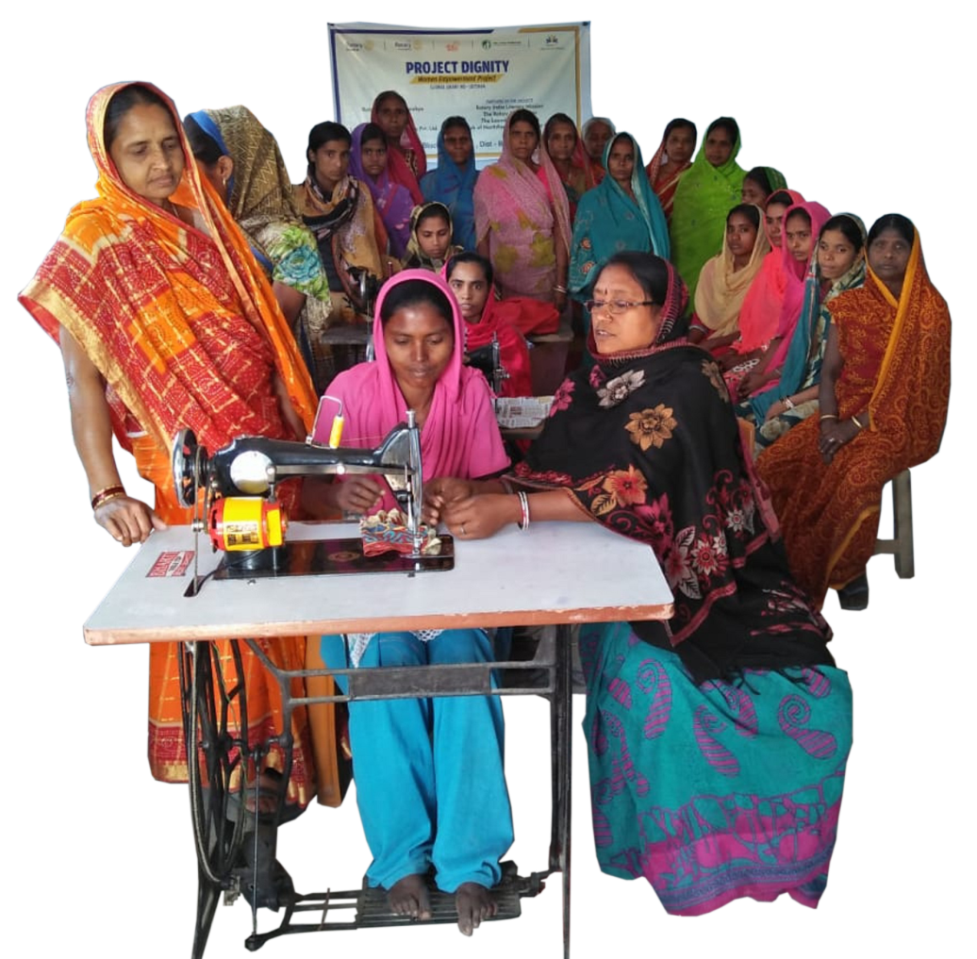
Skill Development
More than
1,000
Women have benefitted
From this project
w w w . r o t a r y t e a c h . o r g

Slide 28

  Saksham Bharat
Pan India Implementation of skilling courses for the healthcare sector
E-learning during Pandemic (120 hours) / Classroom Training post pandemic (120 hours)
On the Job training for 2 to 4 weeks
100 % Placement Assistance, Job roles- General Duty Assistant, Home Health Aide, Geriatric Aide, Pharmacy Assistant
More Skill Sectors programs to follow with renowned organisations
w w w . r o t a r y t e a c h . o r g

Slide 29

Saksham Bharat - Pilot
Pilot Project in 10 cities with Apollo MedSkills
Delhi, Bilaspur, Indore, Patna, Kolkata, Bhubneshwar, Chennai, Kerala, Mumbai, Lucknow
10 Rotarian Coordinators involved
142 youths undergoing training.
w w w . r o t a r y t e a c h . o r g

Slide 30
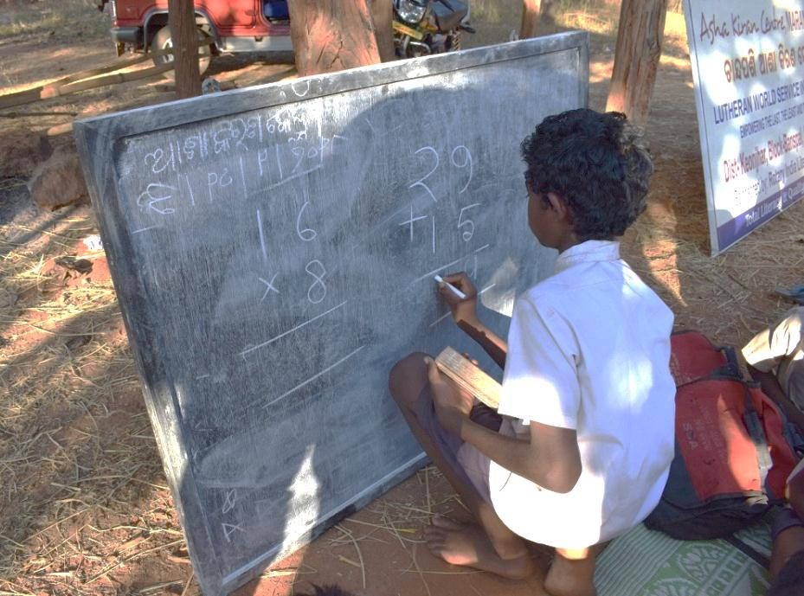
The program also known as Asha Kiran
w w w . r o t a r y t e a c h . o r g

Slide 31
Who are the Asha Kiran Children / Beneficiaries?
Children between age group 7 to 14 years, who:
  have never been to school
  are not attending school but nominally enrolled, irregular, laggard or absent for more than 45 days without informing the school prior to Covid 19 out break
Priorities to be given to following socially vulnerable groups:
Children from socially and economically disadvantaged and vulnerable communities like children of migrant workers, victims of child labour practices, tribal communities and children in need of care and protection etc.
w w w . r o t a r y t e a c h . o r g

Slide 32
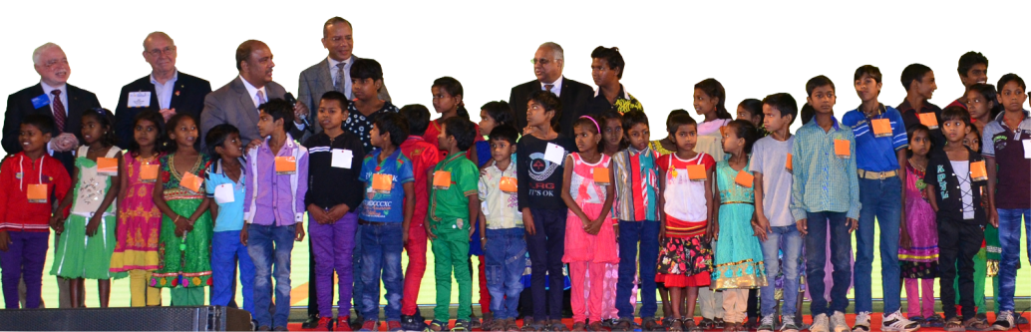
35,078
37,436
Children enrolled in the Asha Kiran program
Children mainstreamed in government schools
w w w . r o t a r y t e a c h . o r g

Slide 33
  Programs for Rotarians
To ensure 1 lacs out of school children back to school.
Build more partnerships with Non Profit Organization.
Building partnership with State Government.
w w w . r o t a r y t e a c h . o r g

Slide 35
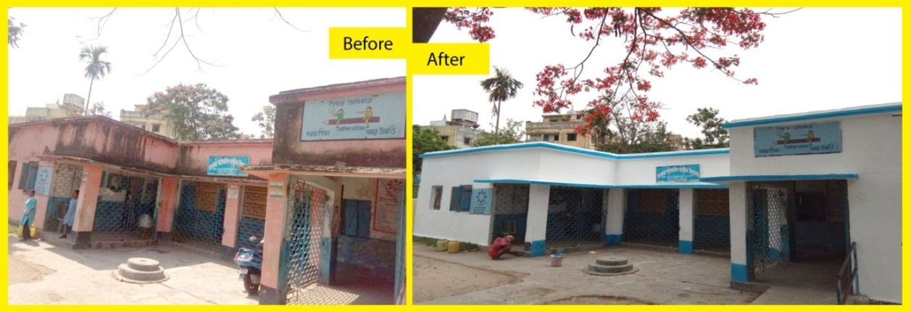
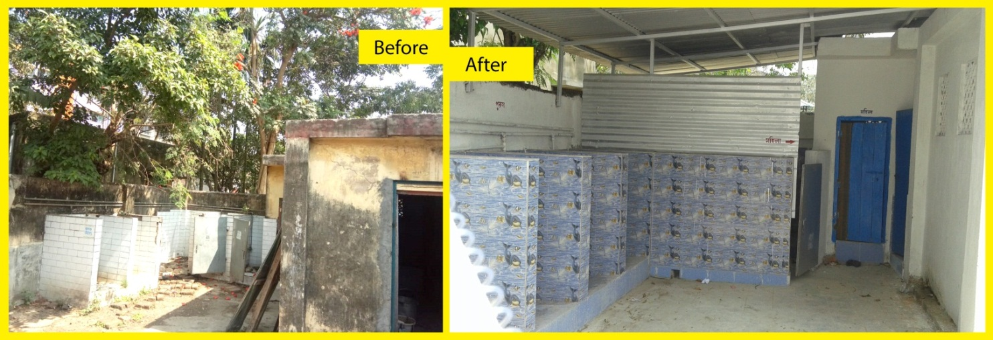
2,964
Govt. & Govt. aided schools have been transformed into Happy School
3,100
Libraries made
w w w . r o t a r y t e a c h . o r g

Slide 36
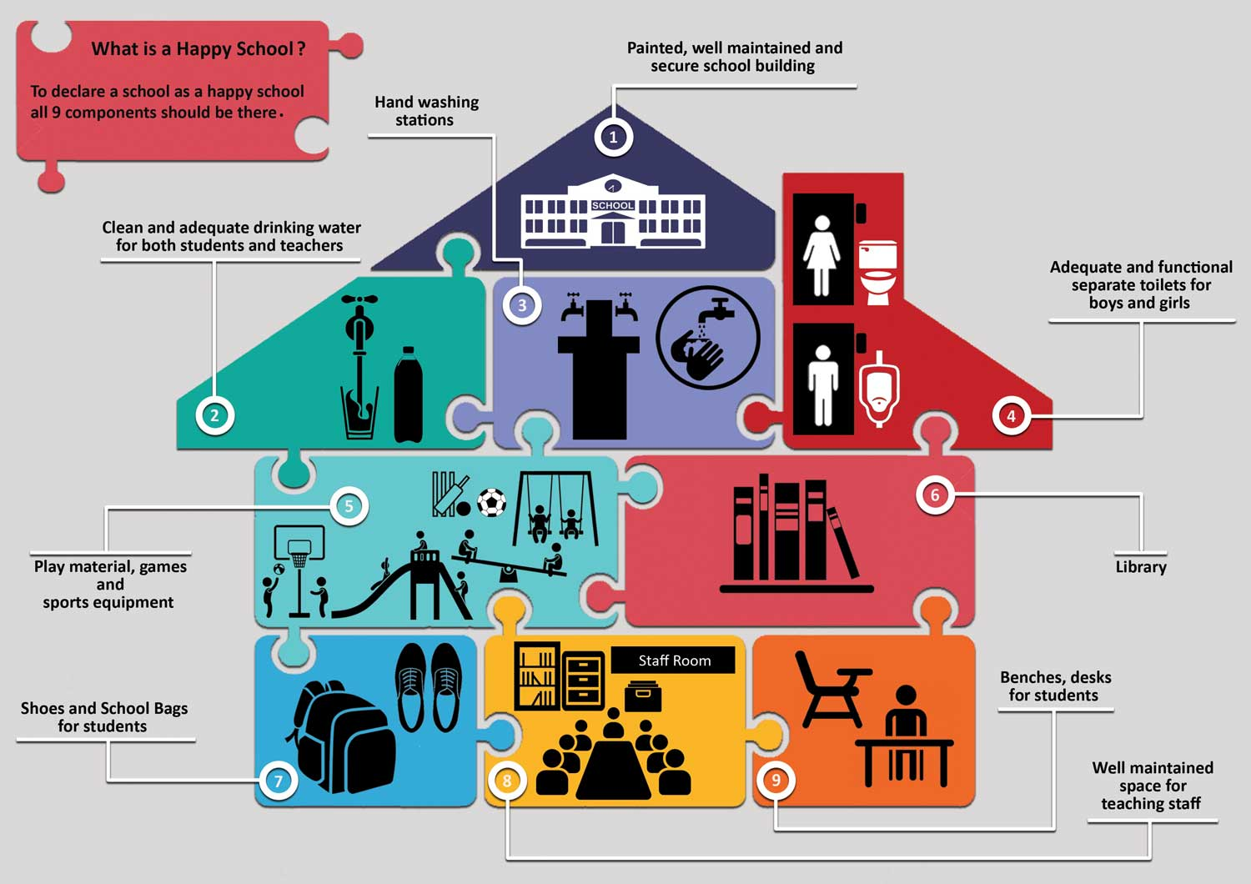
Components of a happy school
w w w . r o t a r y t e a c h . o r g

Slide 37
Partnership
Partner | Targeted Offers
MAGNUM SADOSHIMA ISPAT PVT. LTD. | 1:1 Matching CSR Grant Special Prices for Bulk orders
AMBUJA CEMENT FOUNDATION | BaLa project of renovation of school infrastructure with educative painting on walls. 30 schools in Jiwati in a project worth 50 lakhs, Maharashtra by contributing 2.25 lakhs. Matching grant
RATNA NIDHI OPEN LIBRARY | Ongoing Distribution of 35,000 books to set up libraries
DESKIT BY PROSOC | High end bag with study table, Discount @ 30-38%
INDIAN FOOD BANKING NETWORK | To provide 1 million meals to underprivileged children
PARAGON FOOTWEAR | Discount on Foot wear 36% to 64%
ORIENT BLACKSWAN | Donation of 2.6 million books in 5 states across India
w w w . r o t a r y t e a c h . o r g

Slide 38
Partnership in pipeline
Partner | Targeted Offers
KENT | 33% discount on water purifiers
VISION SPRING | Free eye check up facilities for underprivileged school children at Govt. and Govt. aided schools
ROCHE | Free Medical health checkups for children in Government and Government Aided schools
w w w . r o t a r y t e a c h . o r g

Slide 39
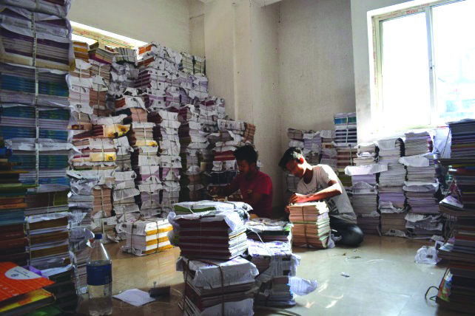
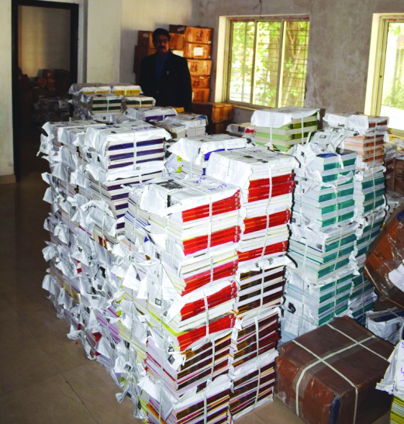
Padho Bharat
Create a library in school with RILM support
RILM to provide 100 books in English language
RC to add 100 more books in local language
w w w . r o t a r y t e a c h . o r g

Slide 40

For more information on T-E-A-C-H, Visit RILM website

